Slide 1

Chemical Process Operator
Career Academy
2016-2017

Slide 2
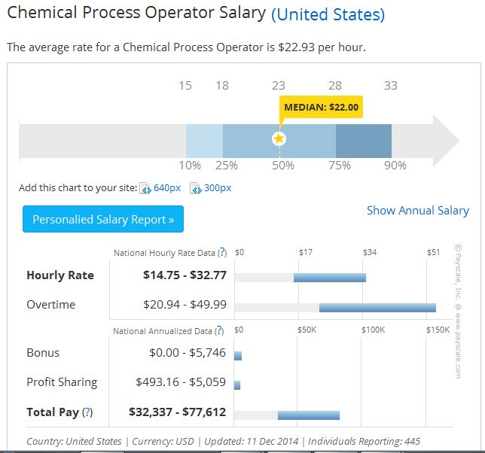
Earning Potential

Slide 3
CPO Certificate Program
The Chemical Process Operations Career Academy program includes courses that prepare individuals for employment in chemical or related industries. In addition to foundation courses in chemistry and physics, students learn about the industrial environment as it relates to process operations and instrumentation.
All courses in the Chemical Process Operations certificate program will articulate into the Associate of Applied Science degree program in General Technology at Northeast State Community College.

Slide 4
CPO Certification
 | Certificate in Chemical Process Operations
 | SUGGESTED TIMELINE:
 |  |  | Credits | Pre-Req. | Location | Total Credit Hours per semester:
Junior- FALL
 | INTC 1010 | Quality & Inspection | 3 credits | NONE | AT DOBYNS-BENNETT or NESCC | 6
 | INTC 1020 | Safety in the Workplace | 3 credits | NONE | AT DOBYNS-BENNETT or NESCC
Junior- SPRING
 | INTC 1041 | Equipment I | 1 credit | NONE | ONLINE | 6
 | INTC 1042 | Equipment II | 1 credit | NONE | ONLINE
 | INTC 1061 | Applied Physical Science | 1 credit | NONE | ONLINE
 | INTC 1070 | Basic Instrumentation | 3 credits | NONE | PARTIALLY ONLINE; LAB AT DOBYNS-BENNETT or NESCC
Senior- FALL
 | CHEM 1030 | Intro. to Chemistry | 4 credits | ACT Math, Reading, English | DUAL CREDIT AT DOBYNS-BENNETT | 7
 | MATH 1100 | Intermediate Algebra | 3 credits | ACT Math | AT DOBYNS-BENNETT or NESCC
Senior- SPRING
 | CHEM 1110 | General Chemistry I | 4 credits | MATH 1100 or CHEM 1035 | AT DOBYNS-BENNETT or NESCC | 6
 | ELECTIVE | Technical Elective | 2 credits | NONE | AT DOBYNS-BENNETT or NESCC
GRADUATE WITH A CERTIFICATE FROM NESCC IN CHEMICAL PROCESS OPERATIONS.

